Slide 1
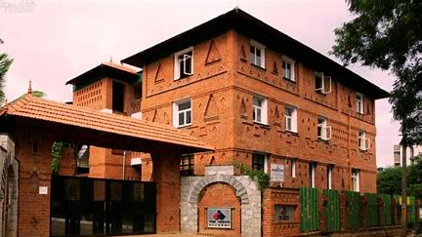
INTRODUCING THE FACULTY
GRADE 6A

Slide 2
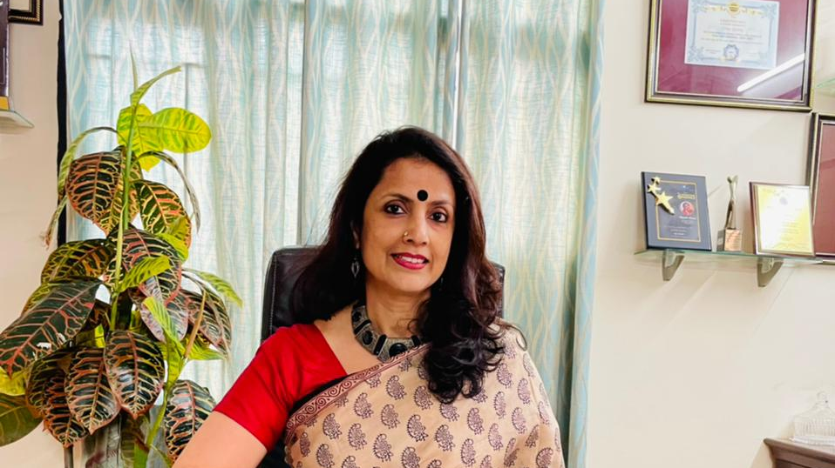
MS. SHANTHI MENON
PRINCIPAL

Slide 3
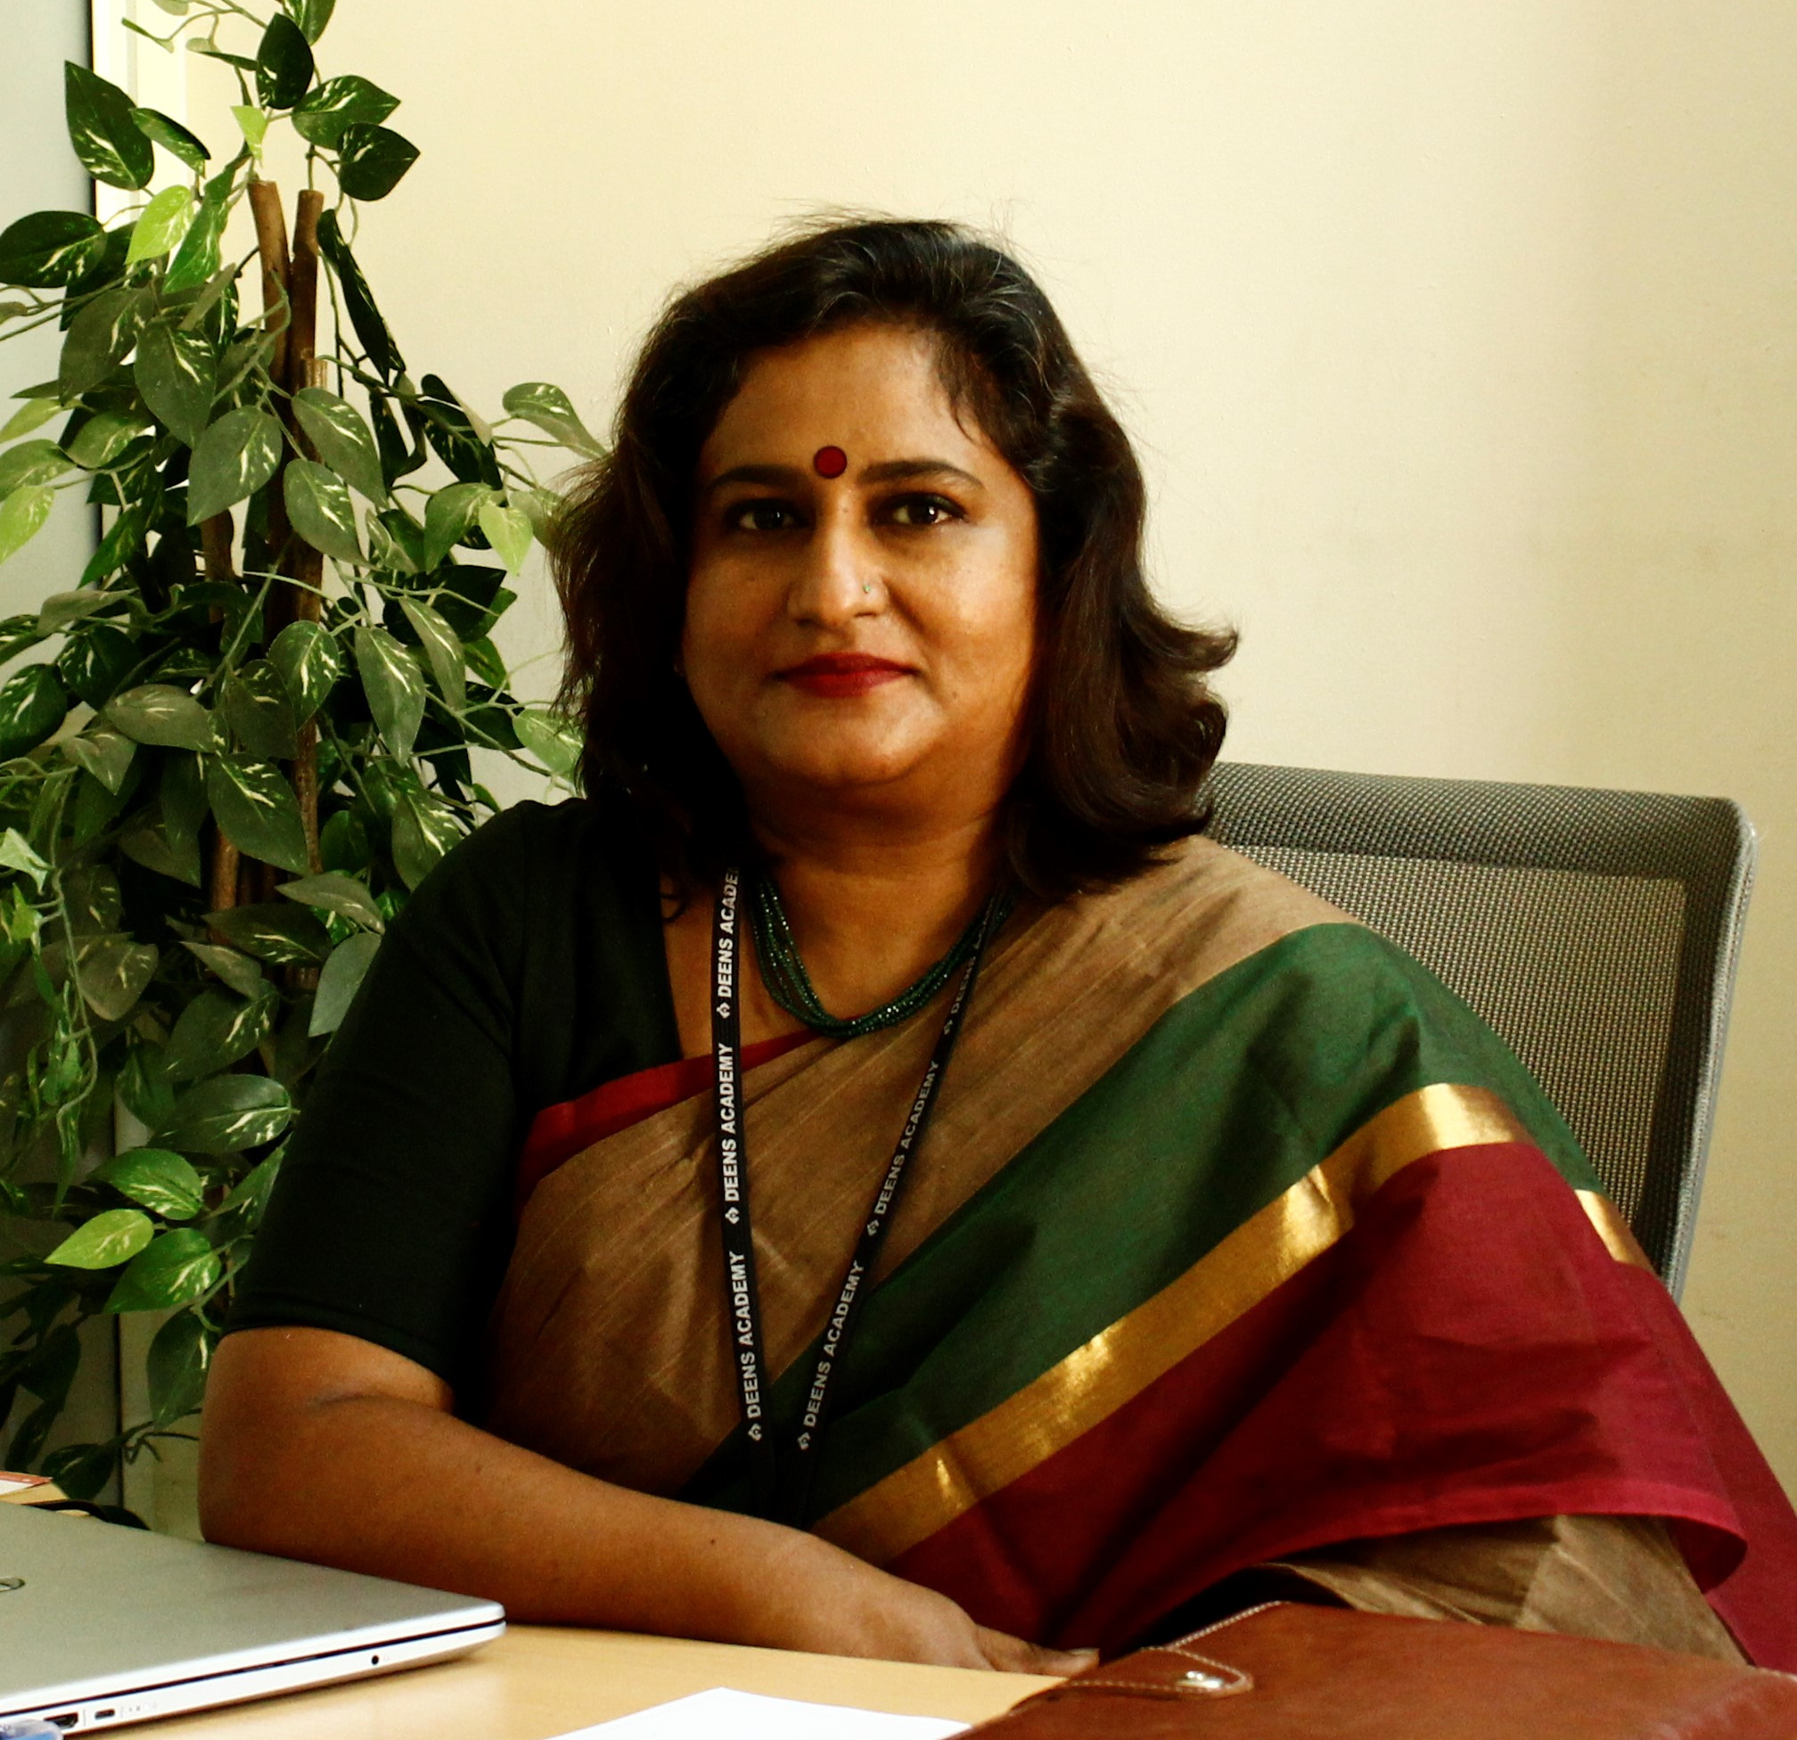
MS. DEEPA RAJEEV
VICE PRINCIPAL

Slide 4
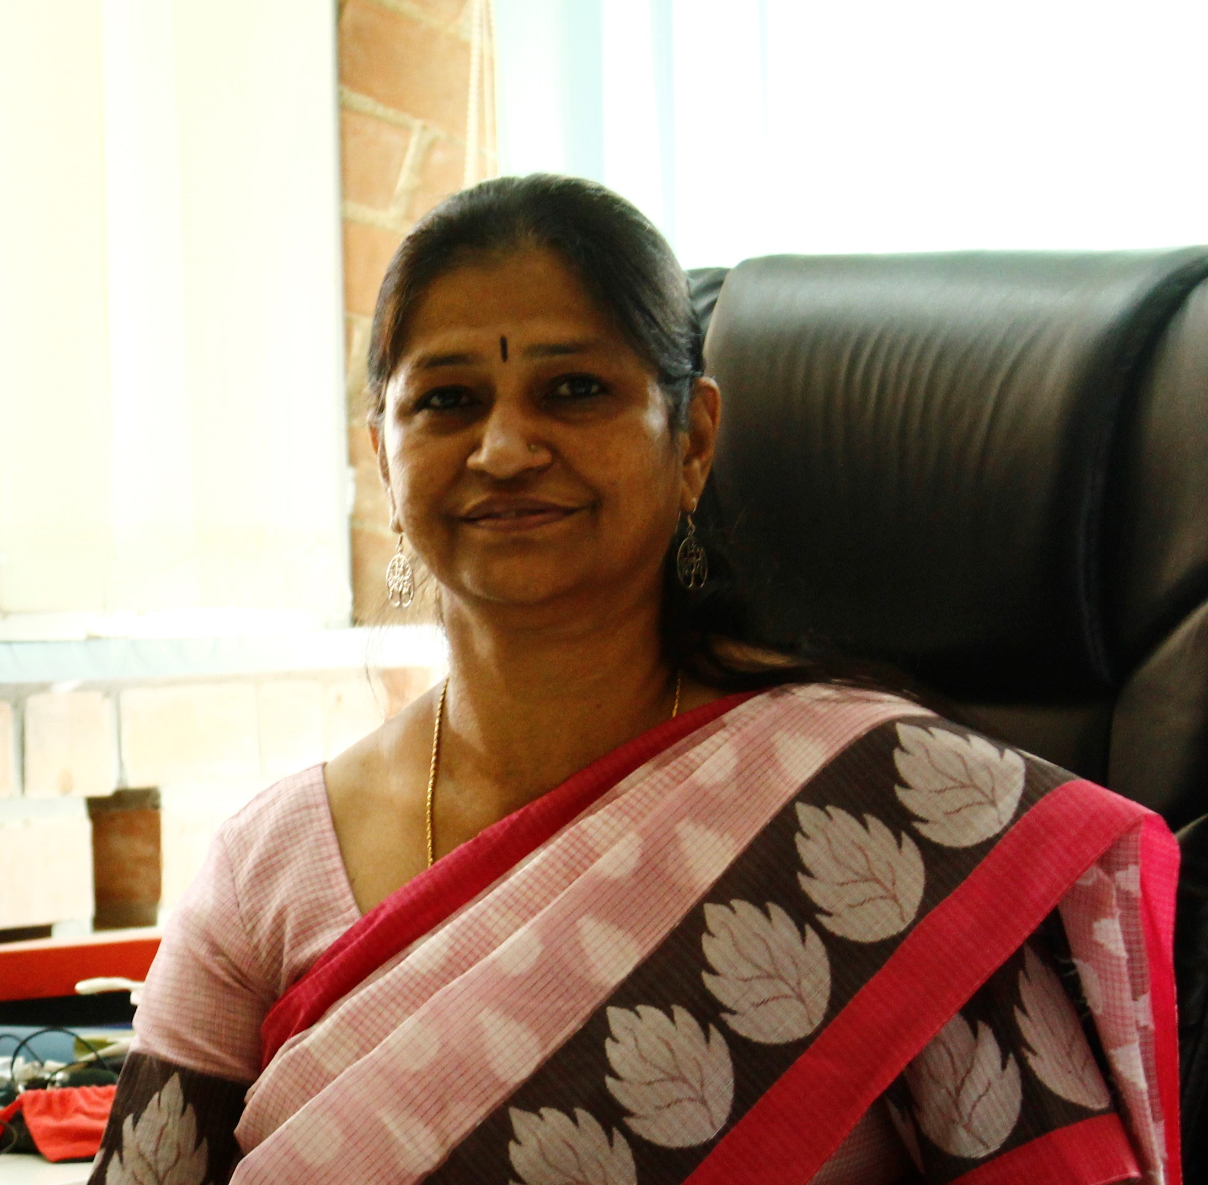
MS. SARALA NAIR HEADMISTRESS MIDDLE SCHOOL

Slide 5
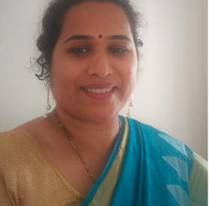
MS. ANU NAIR
– CLASS TEACHER 6A,
FACULTY FOR MATH

Slide 6
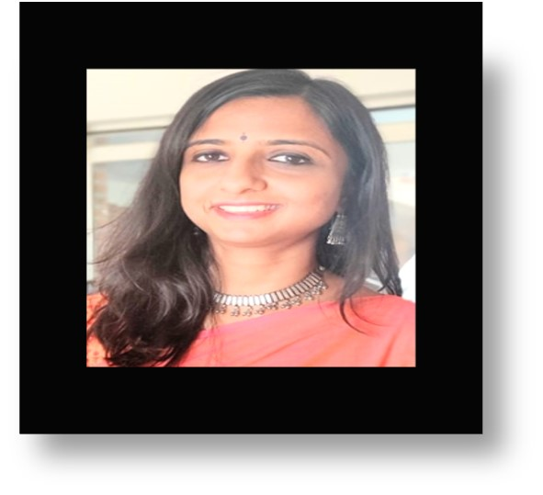
Ms. NIRANJANA FACULTY FOR ENGLISH, CREATIVE WRITING

Slide 7
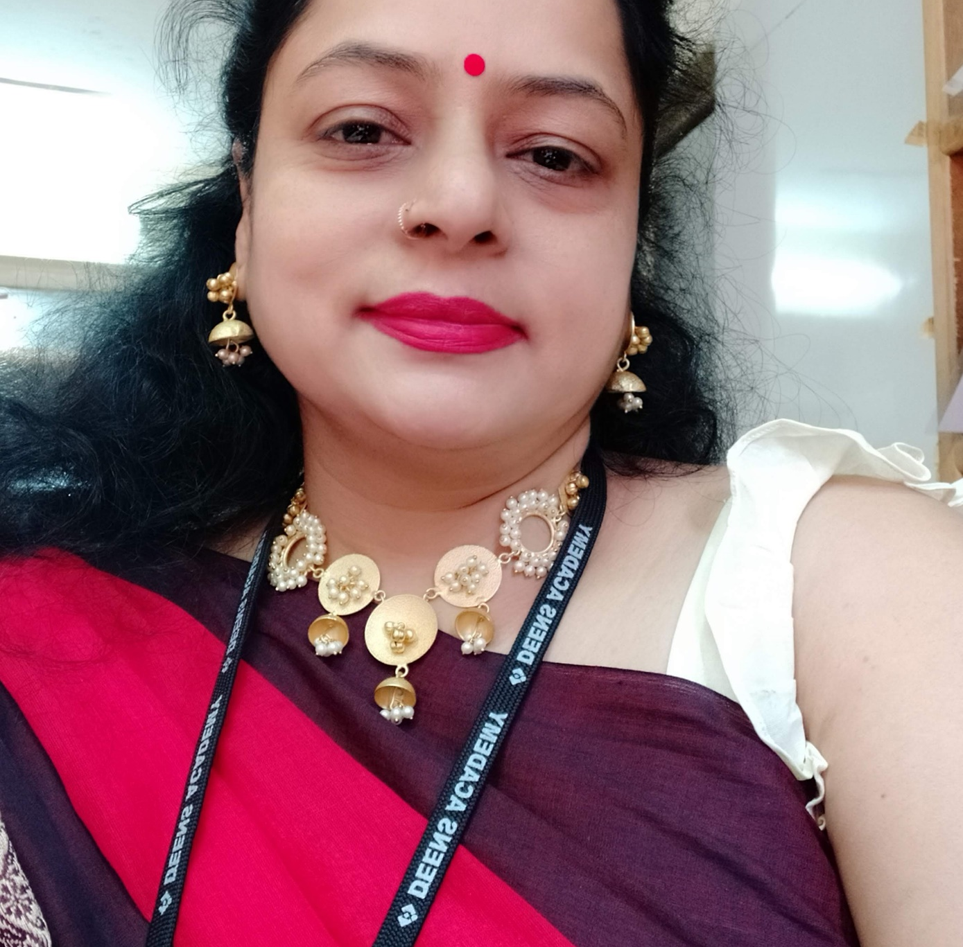
MS. SHEETAL JAIN
FACULTY FOR
HINDI(II LANGUAGE)

Slide 8
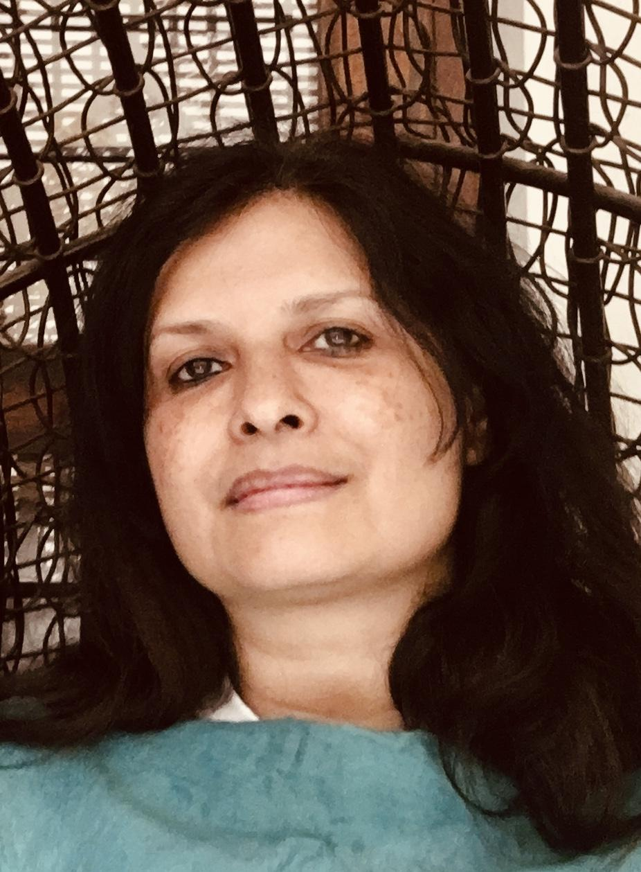
MS. GENEVIEVE CASTELLINO
FACULTY FOR
FRENCH(II LANGUAGE)

Slide 9
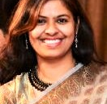
MS.KAMALAKSHI PATHAK
FACULTY FOR SANSKRIT(II LANGUAGE)

Slide 10
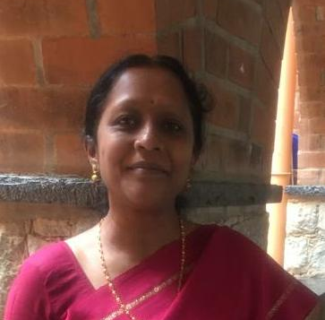
MS. MANJULA R FACULTY FOR
KANNADA (II LANGUAGE)

Slide 11
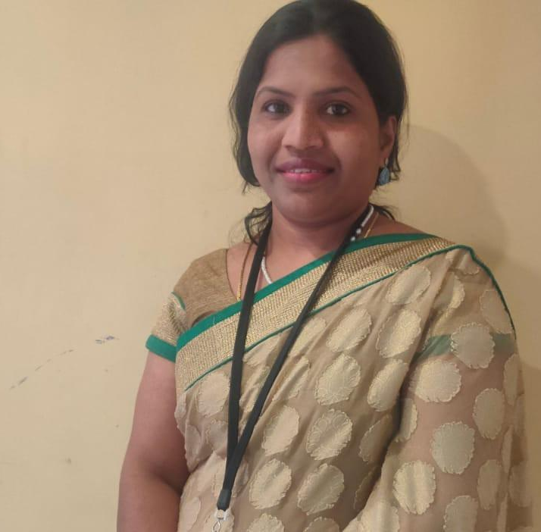
MS. CHITRALEKHA FACULTY FOR
KADDAYA KANNADA

Slide 12
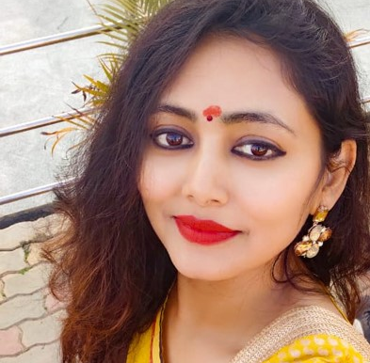
MS.PRIYANKA SINGH FACULTY FOR
ELECTIVE HINDI

Slide 13
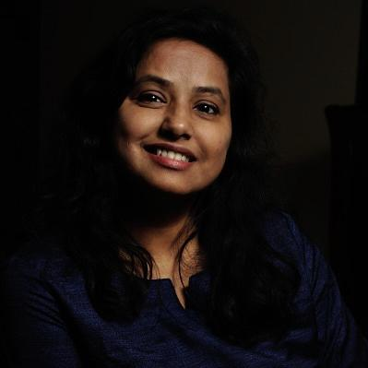
MS.DIVYA M
FACULTY FOR PHYSICS

Slide 14
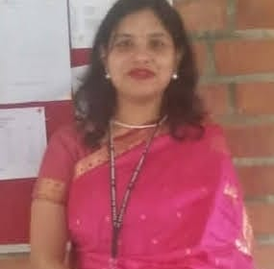
MS. PAMELA
FACULTY FOR CHEMISTRY

Slide 15
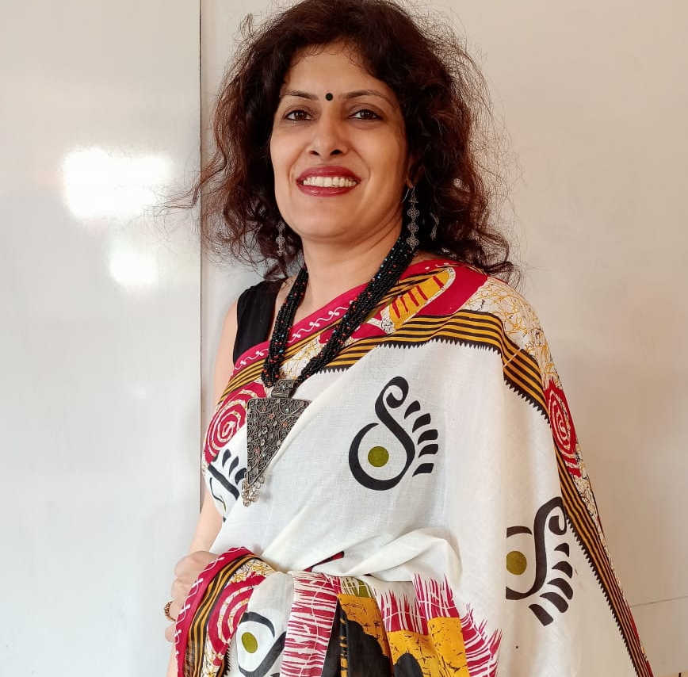
MS.TRIPTA BHATIA
FACULTY FOR BIO

Slide 16
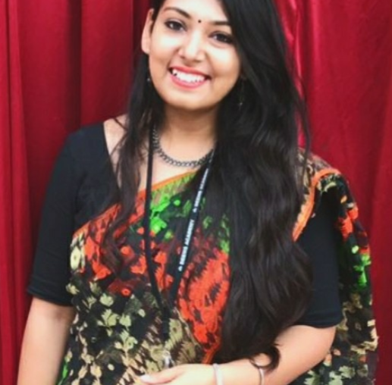
MS. NAYANIKA BANERJEE
FACULTY FOR HISTORY

Slide 17
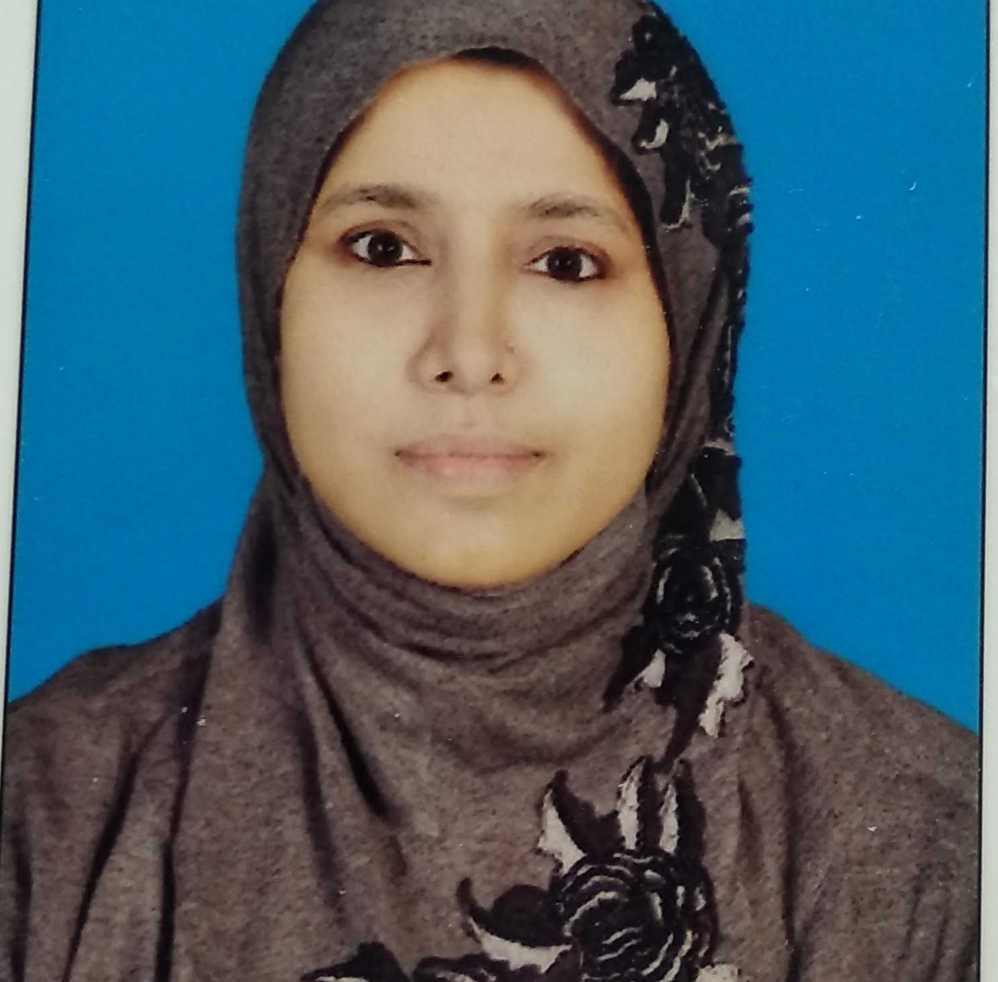
MS. NAUSHBHA
FACULTY FOR GEOGRAPHY

Slide 18
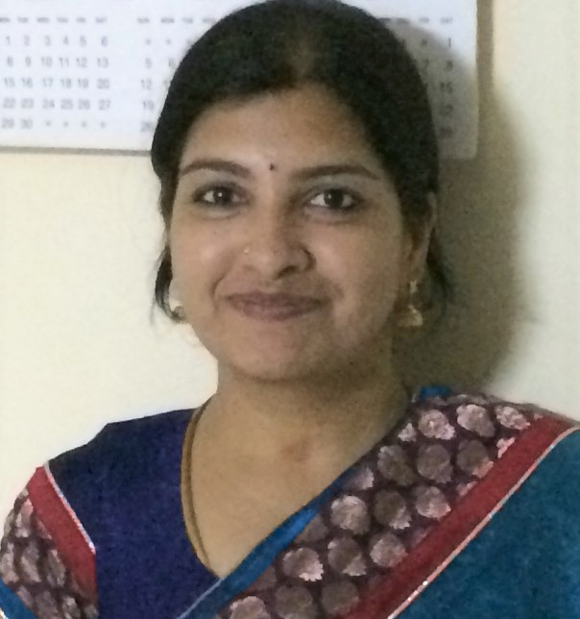
MS. APARNA HARIHARAN FACULTY FOR COMPUTER SCIENCE

Slide 19
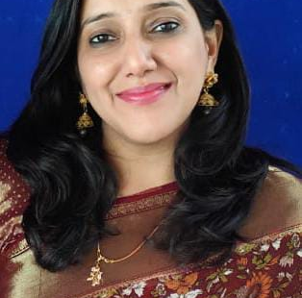
MS. GEETU NARANG
FACULTY FOR
ART AND CRAFT

Slide 20
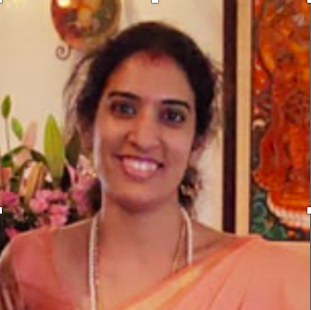
MS. SRIKALA RAJU
FACULTY FOR QUIZ

Slide 21
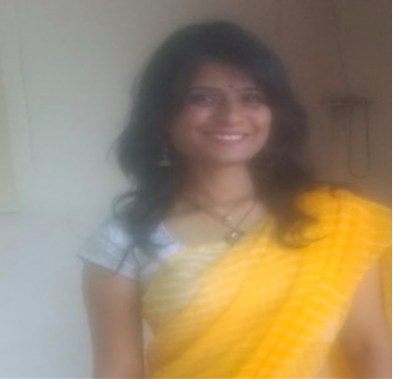
MS. RAJITA
FACULTY FOR YOGA

Slide 22
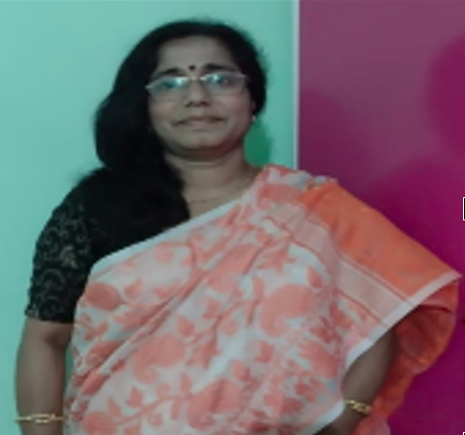
MS. DIPANWITA
FACULTY FOR INDIAN MUSIC

Slide 23
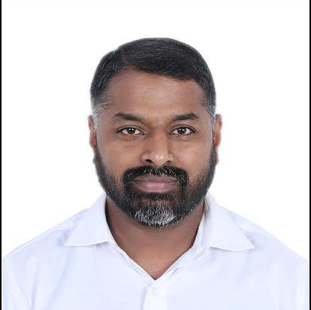
MR. SAM SUNDER
FACULTY FOR WESTERN MUSIC

Slide 24
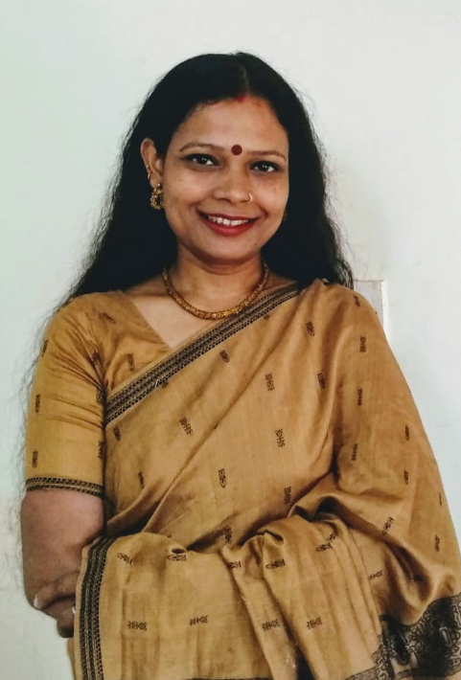
MS. PRACHI SHARAN
FACULTY FOR
INDIAN DANCE

Slide 25
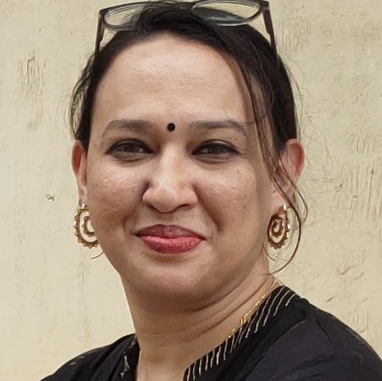
MS. DEMELZA
FACULTY FOR WESTERN DANCE

Slide 26
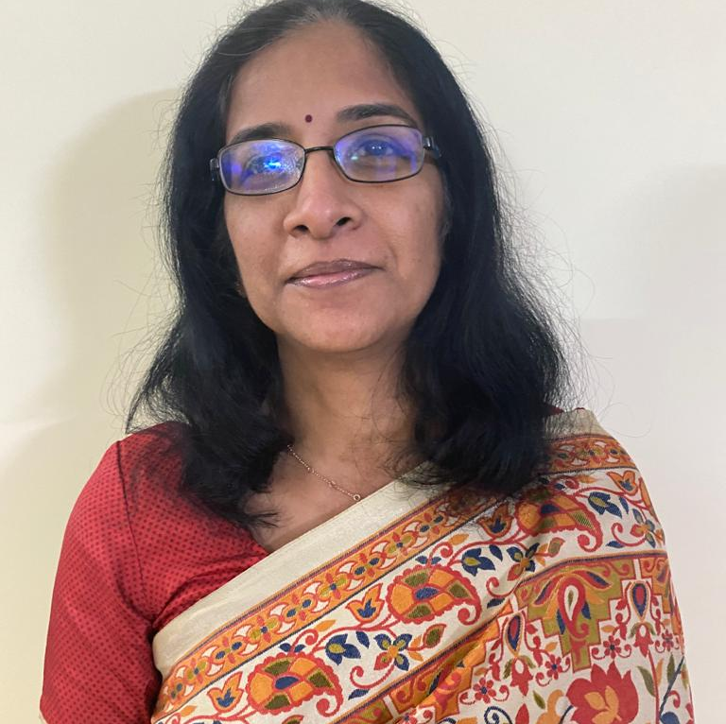
MS. NISHA K
FACULTY FOR LIBRARY

Slide 27
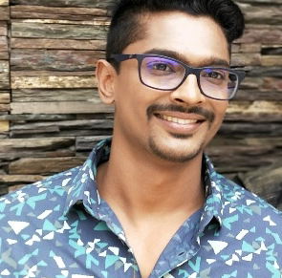
MR.PRASAD K FACULTY FOR
THEATRE IN EDUCATION

Slide 28
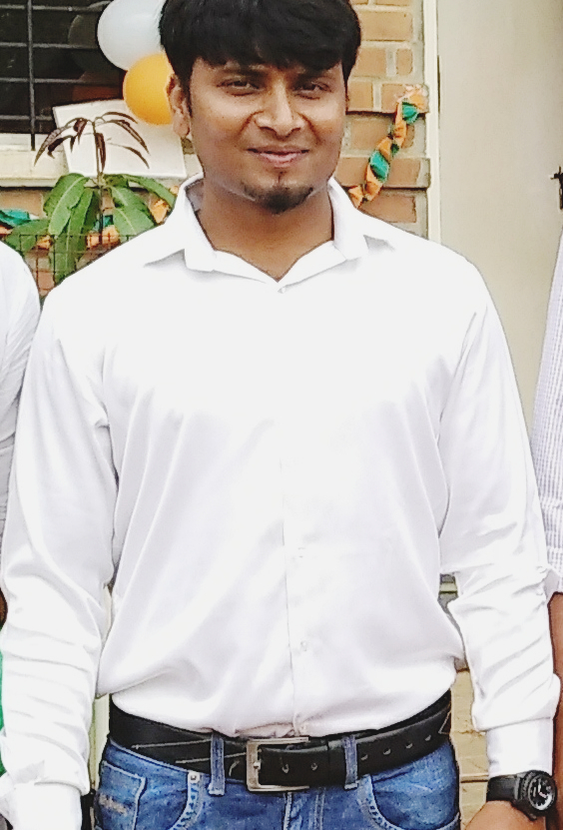
MR. PARASURAMA
FACULTY FOR
PHYSICAL EDUCATION

Slide 29
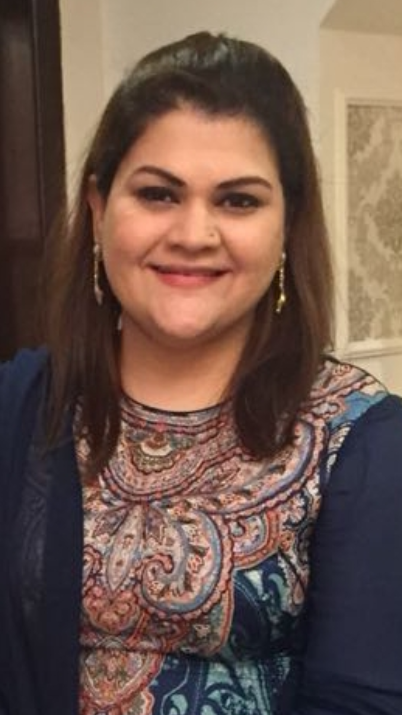
MS. SAMA ADIL – COUNSELLOR
EMAIL ID: sama.adil@deensacademy.com

