Slide 1
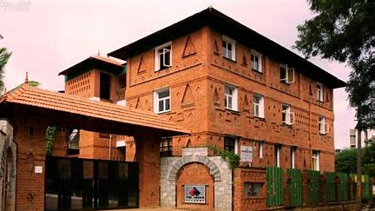
INTRODUCING THE FACULTY
GRADE 6C

Slide 2
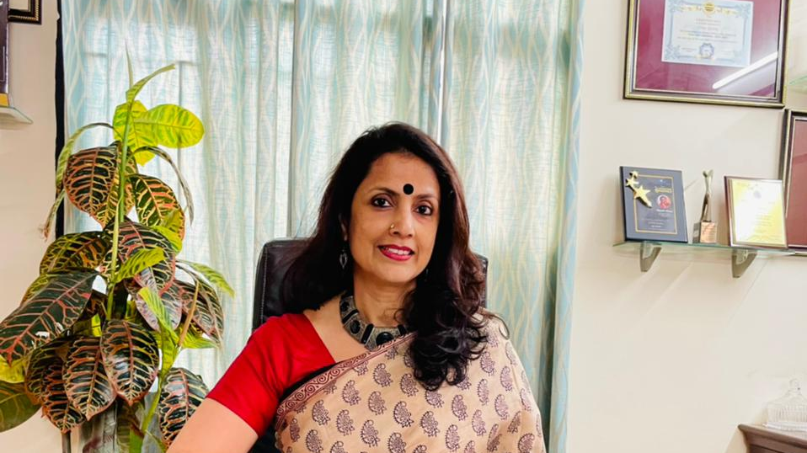
MS. SHANTHI MENON
PRINCIPAL

Slide 3
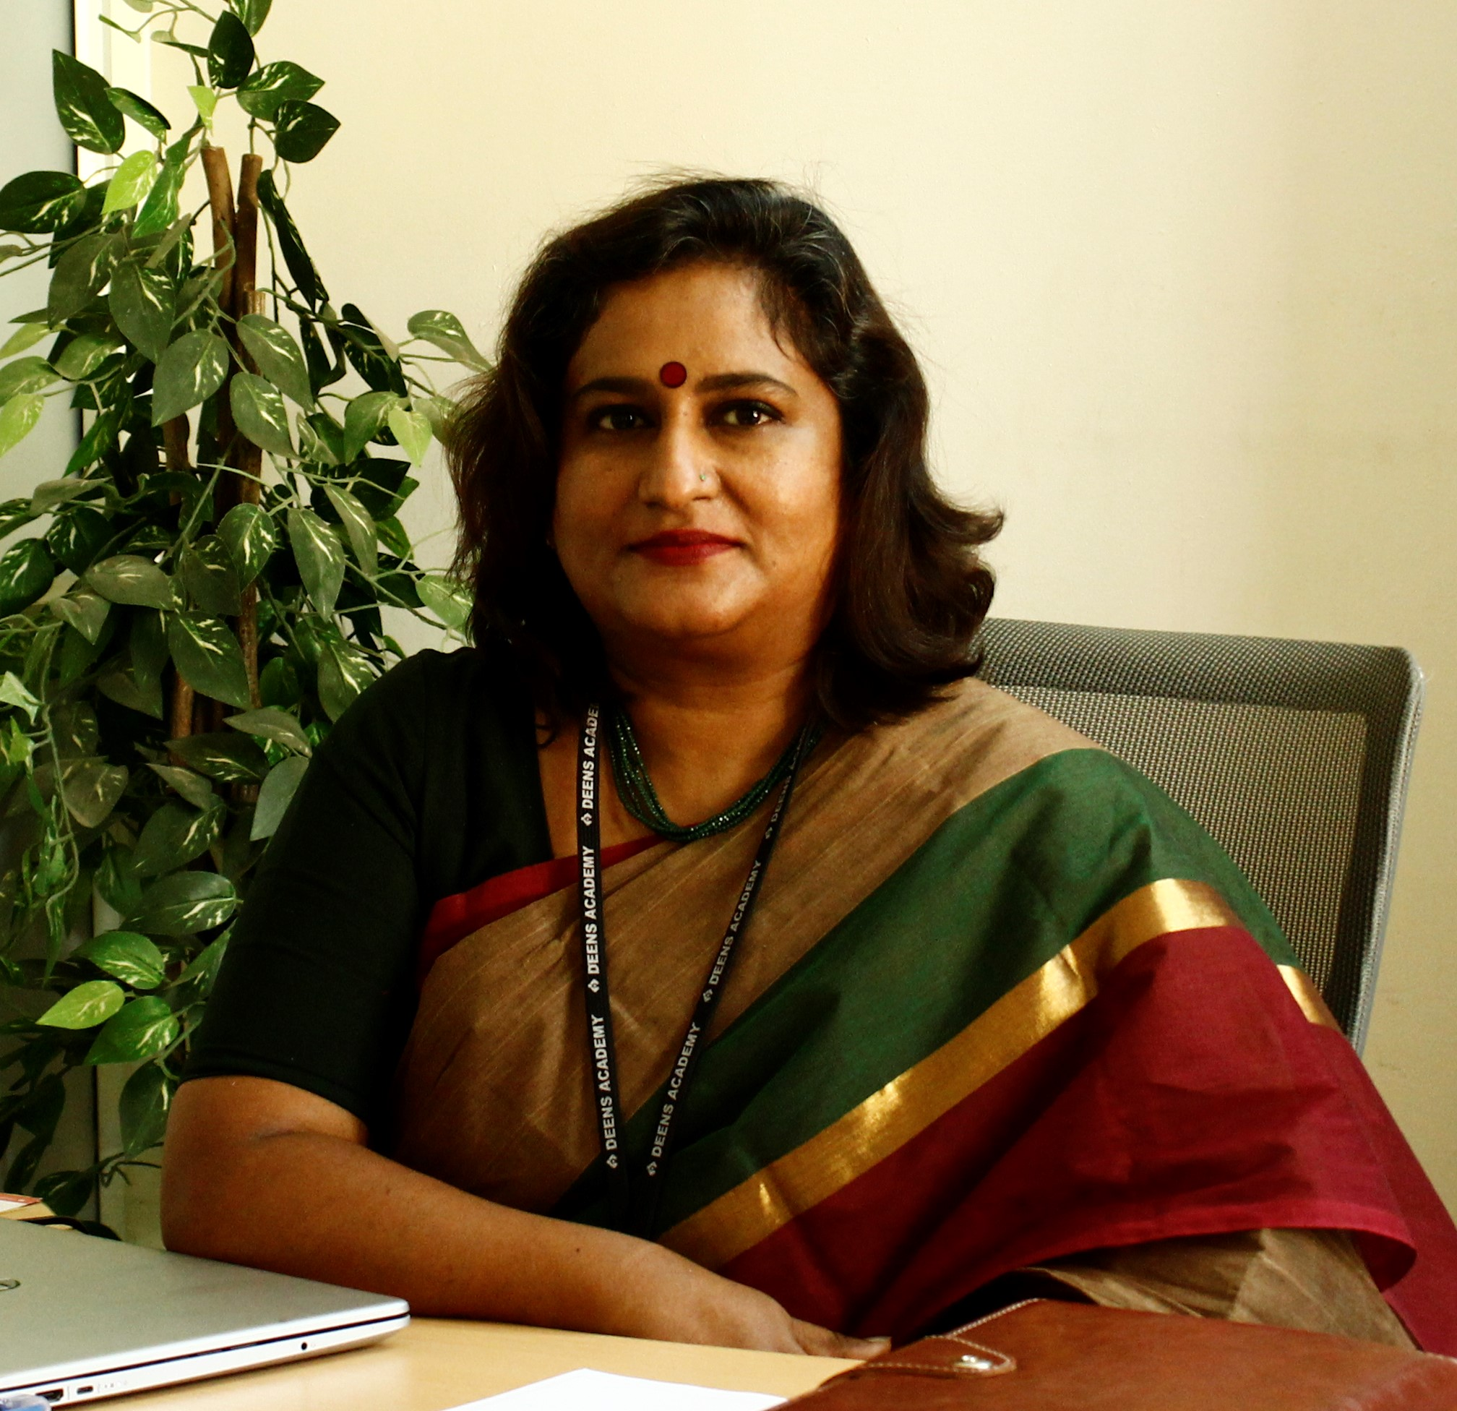
MS. DEEPA RAJEEV
VICE PRINCIPAL

Slide 4
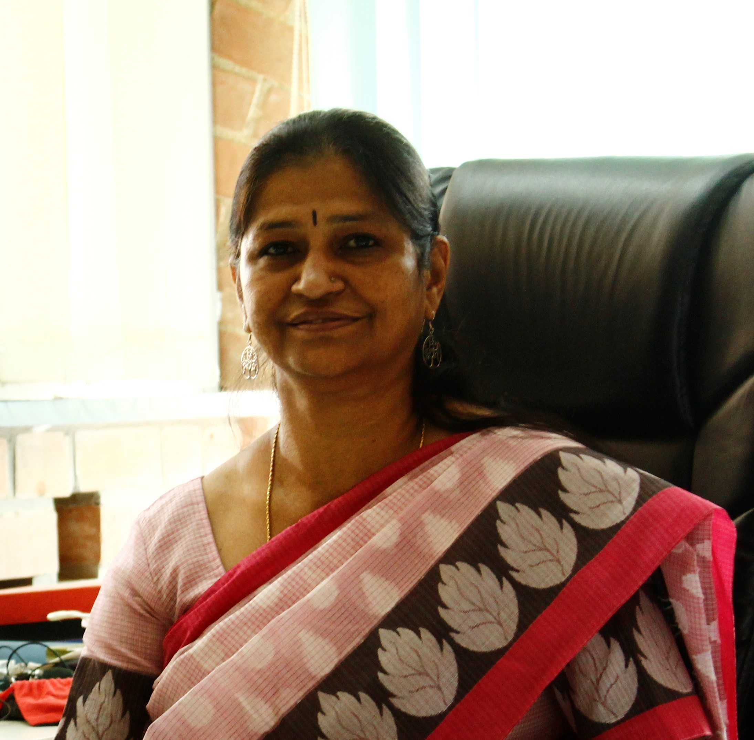
MS. SARALA NAIR HEADMISTRESS MIDDLE SCHOOL

Slide 5
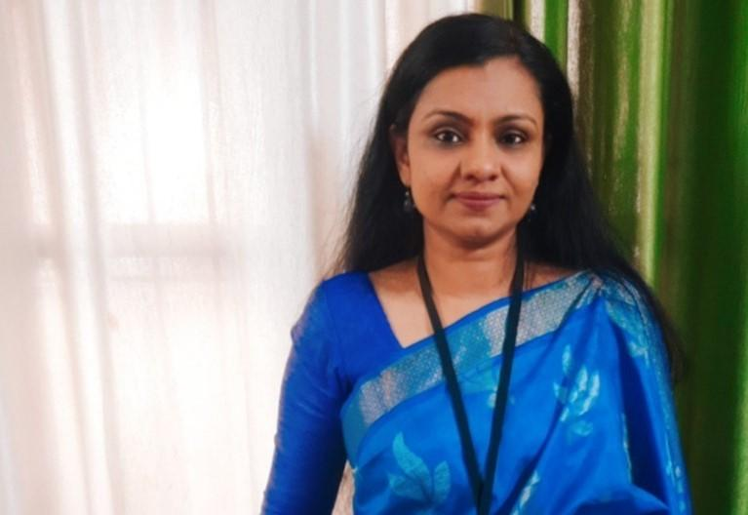
MS. ARUTH THOMAS–
CLASS TEACHER 6C,
FACULTY FOR
ENGLISH ,CREATIVE WRITING

Slide 6
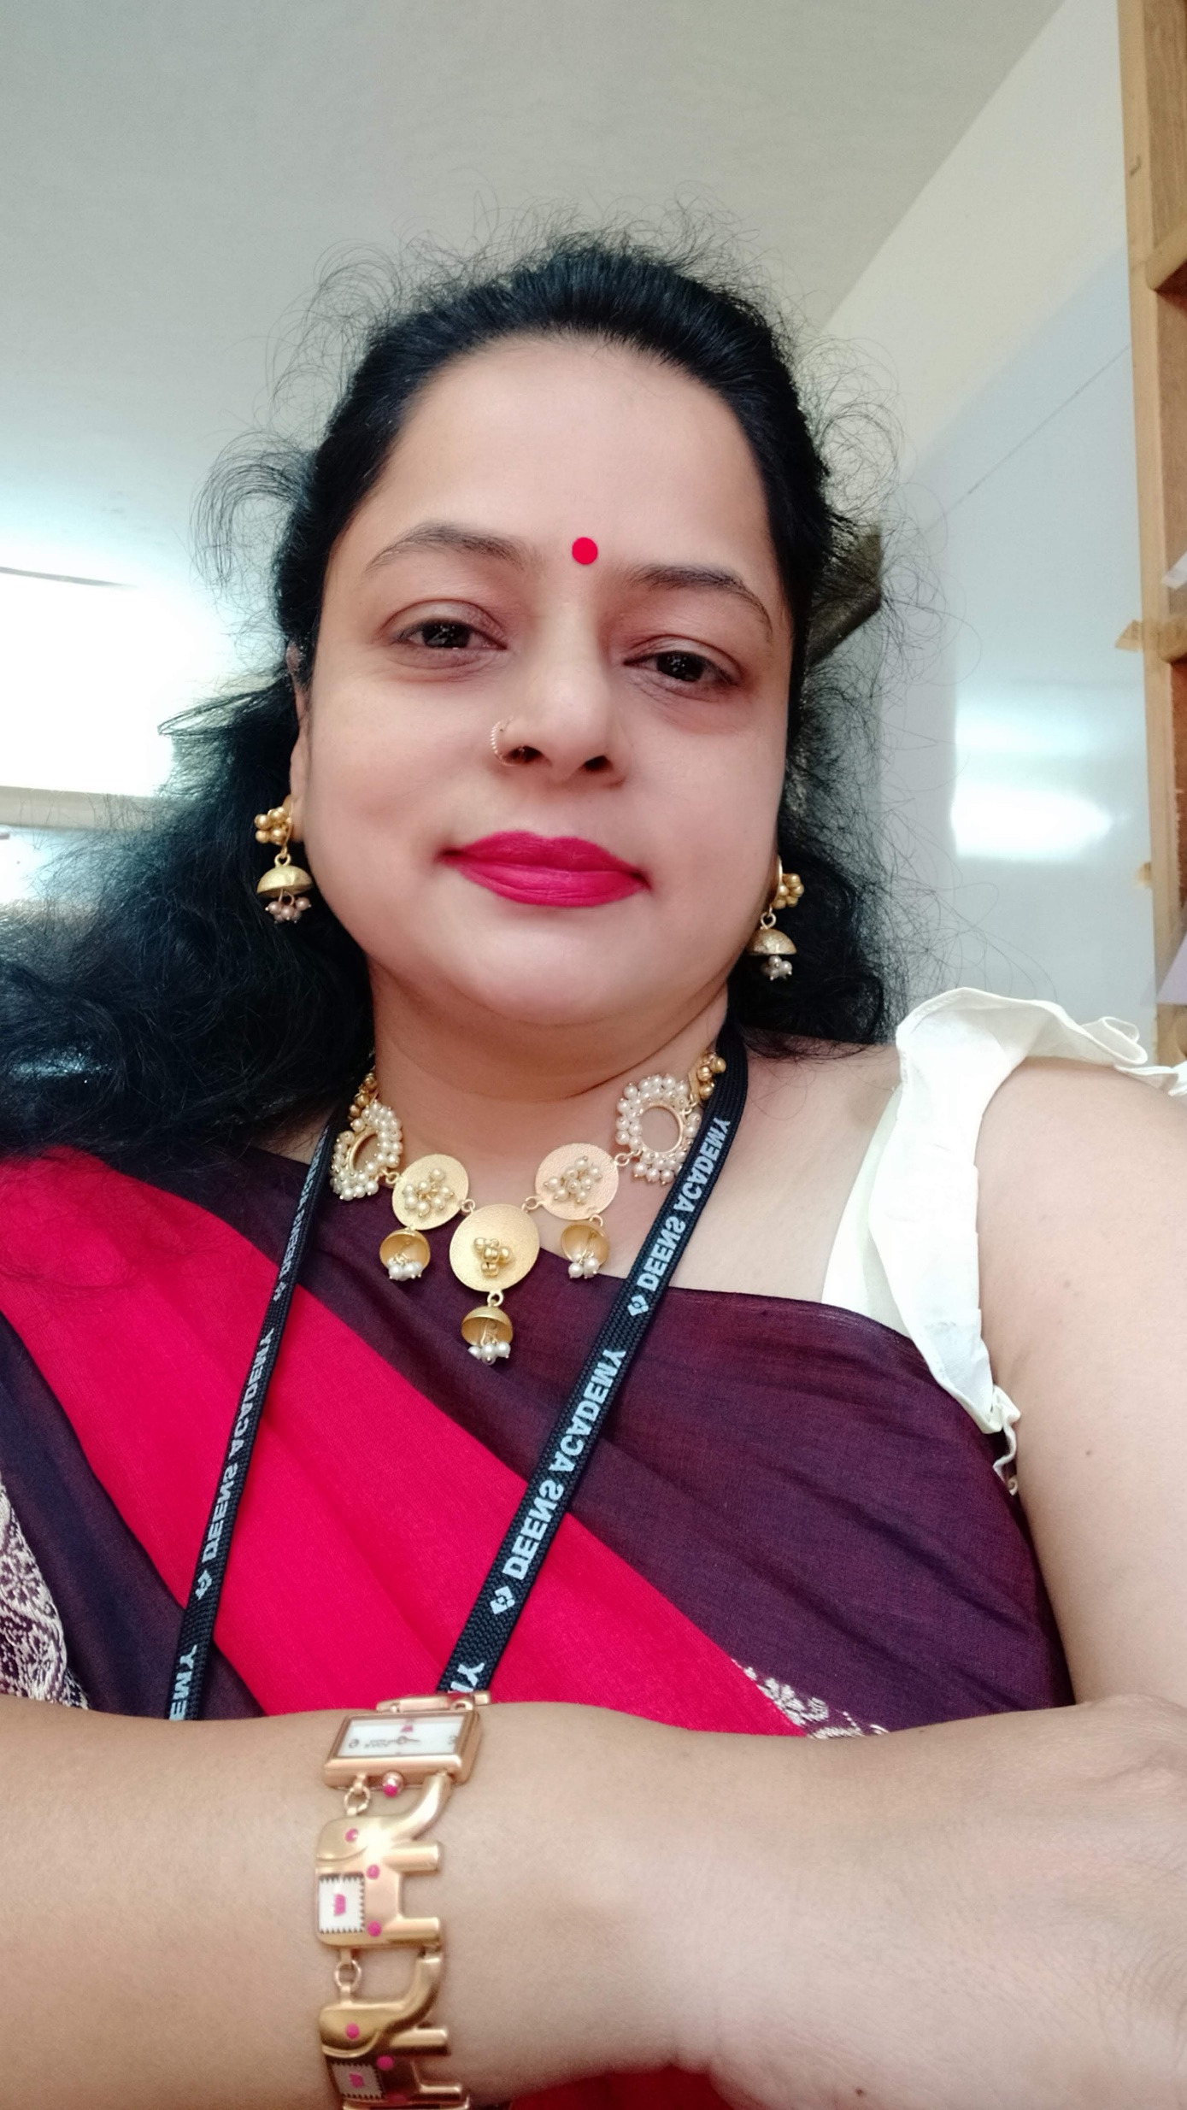
MS. SHEETAL JAIN
FACULTY FOR
HINDI(II LANGUAGE)

Slide 7
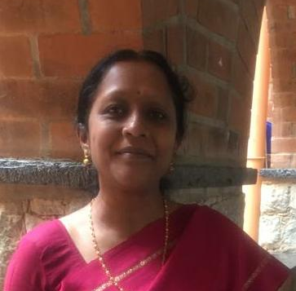
MS. MANJULA R FACULTY FOR
KADDYA KANNADA

Slide 8
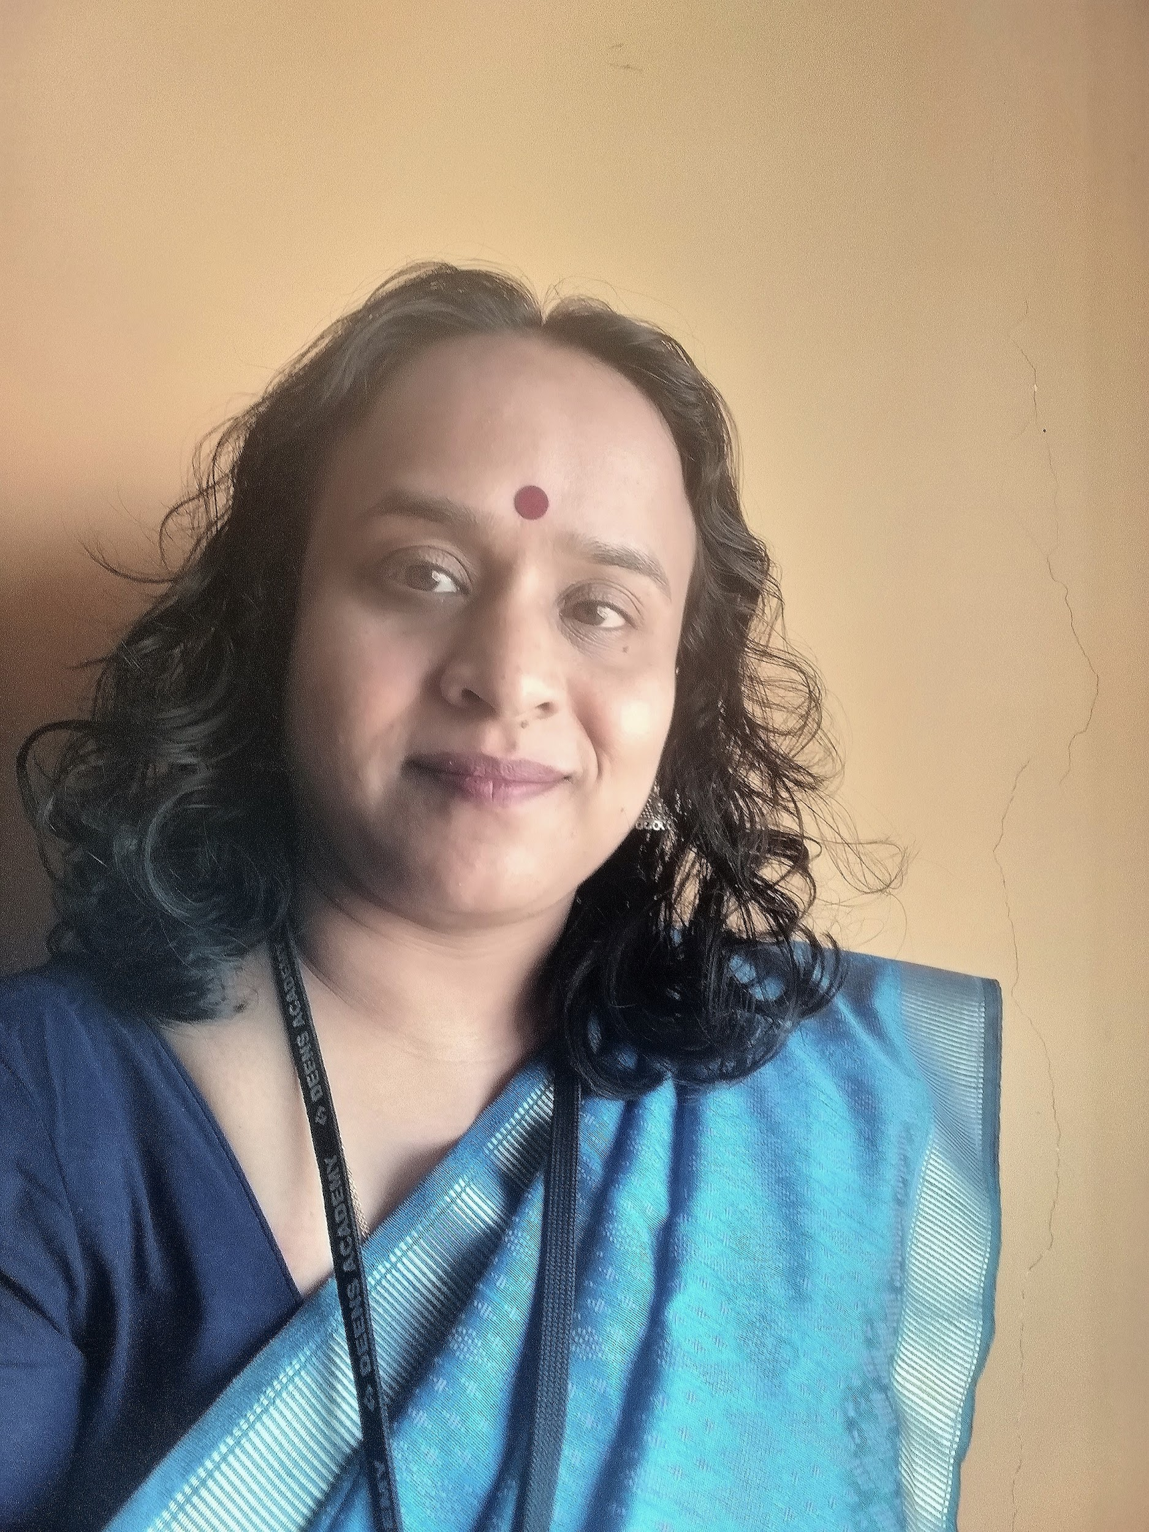
MS.APARAJITHA
FACULTY FOR MATH

Slide 9
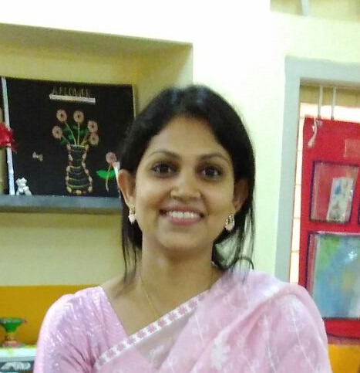
MS.SAMINA NIKAT FACULTY FOR PHYSICS

Slide 10
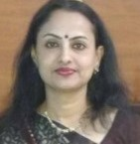
MS. SUNITA SUNIL FACULTY FOR CHEMISTRY

Slide 11
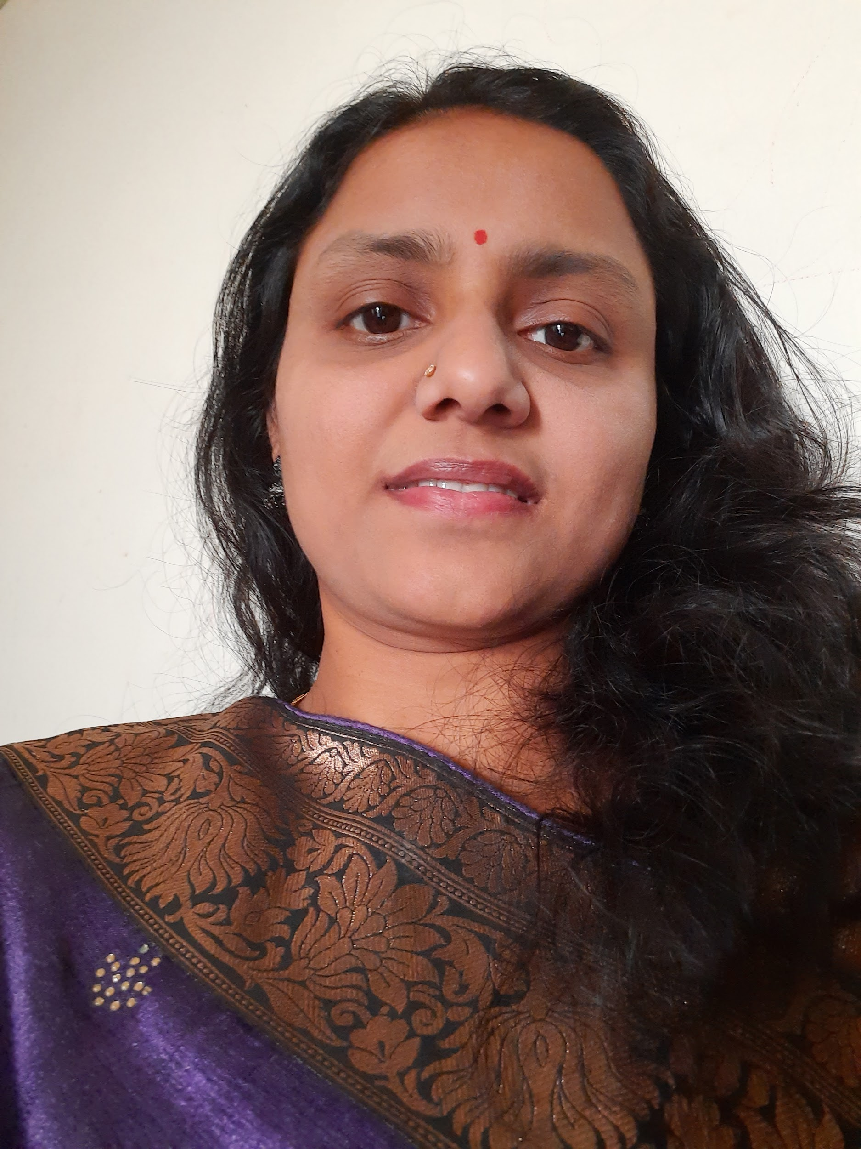
MS. NAMITHA S FACULTY FOR
BIOLOGY

Slide 12
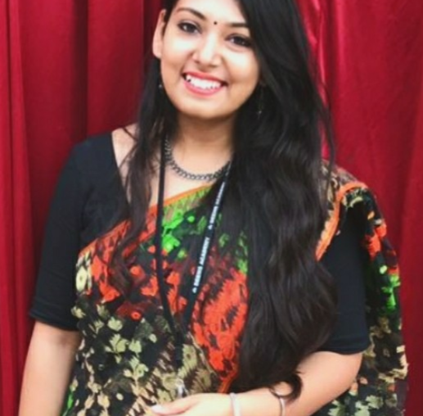
MS. NAYANIKA BANERJEE
FACULTY FOR HISTORY

Slide 13
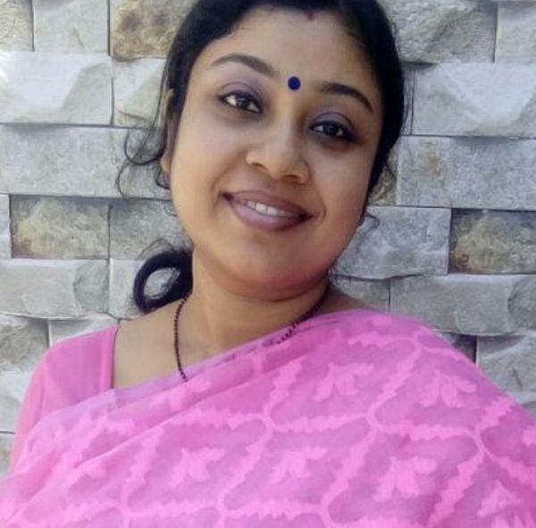
MS. DEBASHREE
FACULTY FOR GEOGRAPHY

Slide 14
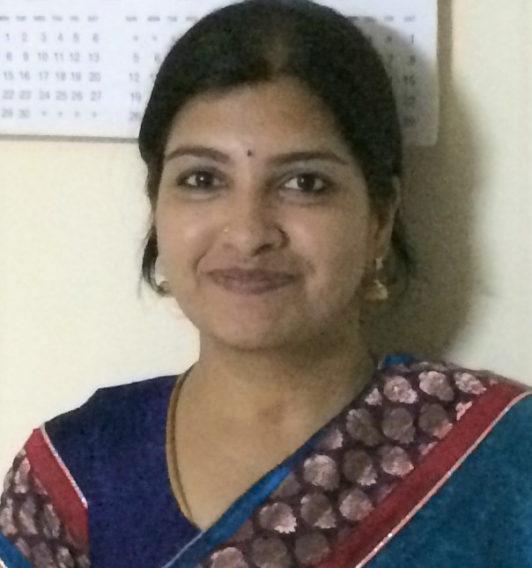
MS. APARNA HARIHARAN FACULTY FOR COMPUTER SCIENCE

Slide 15
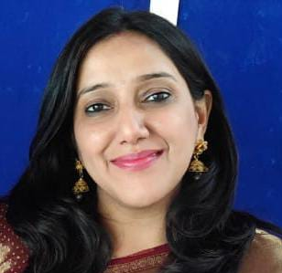
MS. GEETU NARANG
FACULTY FOR
ART AND CRAFT

Slide 16
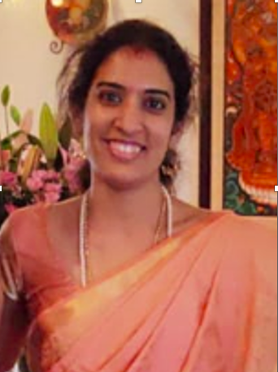
MS. SRIKALA RAJU
FACULTY FOR QUIZ

Slide 17
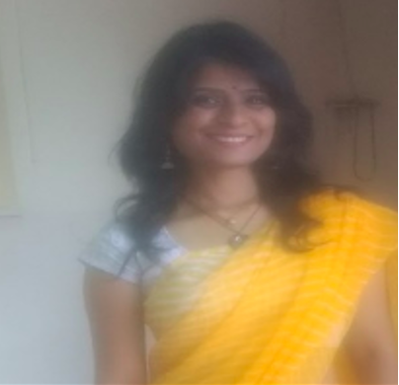
MS. RAJITA
FACULTY FOR YOGA

Slide 18
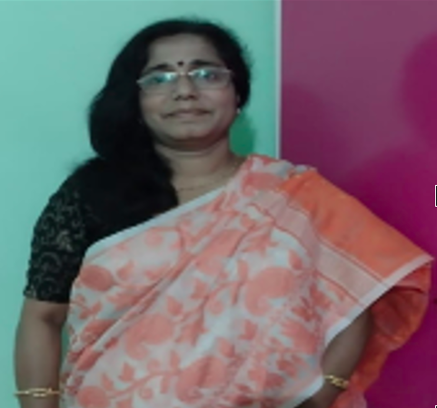
MS. DIPANWITA
FACULTY FOR INDIAN MUSIC

Slide 19
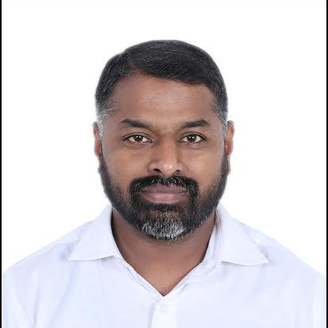
MR. SAM SUNDER
FACULTY FOR WESTERN MUSIC

Slide 20
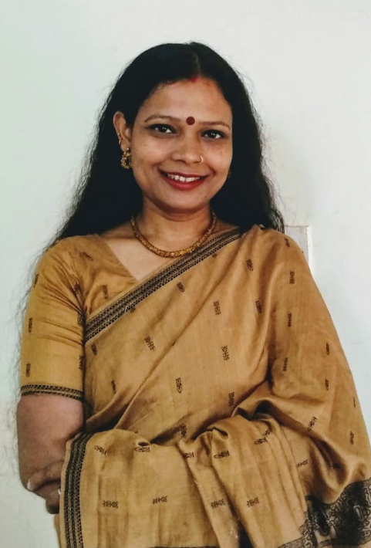
MS. PRACHI SHARAN
FACULTY FOR
INDIAN DANCE

Slide 21
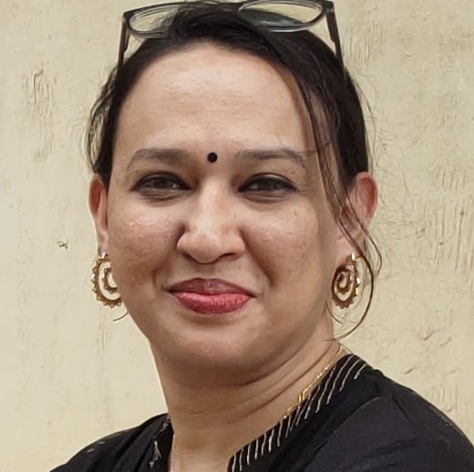
MS. DEMELZA
FACULTY FOR WESTERN DANCE

Slide 22
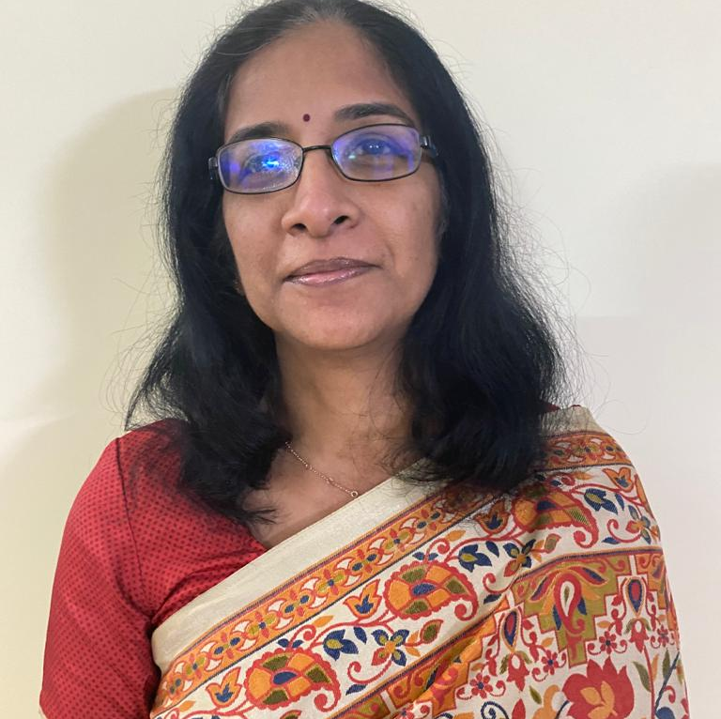
MS. NISHA K
FACULTY FOR LIBRARY

Slide 23
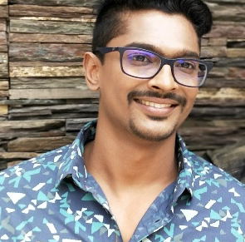
MR.PRASAD K FACULTY FOR
THEATRE IN EDUCATION

Slide 24
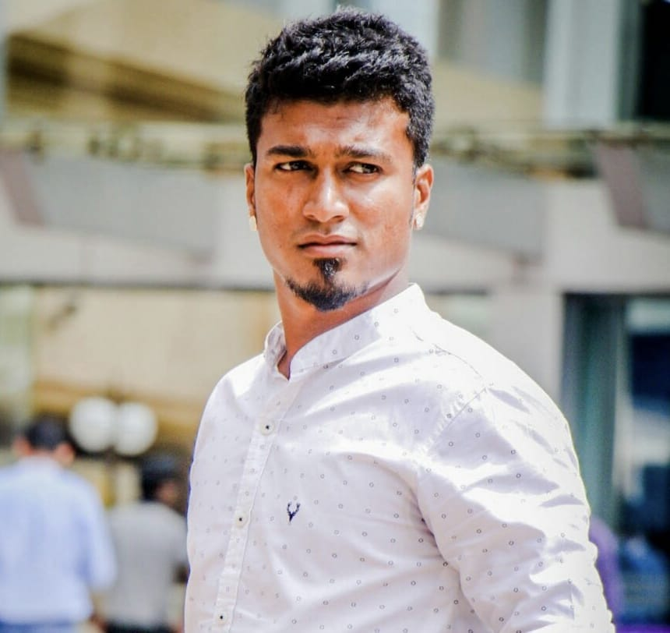
MR. NAVEEN
FACULTY FOR
PHYSICAL EDUCATION

Slide 25
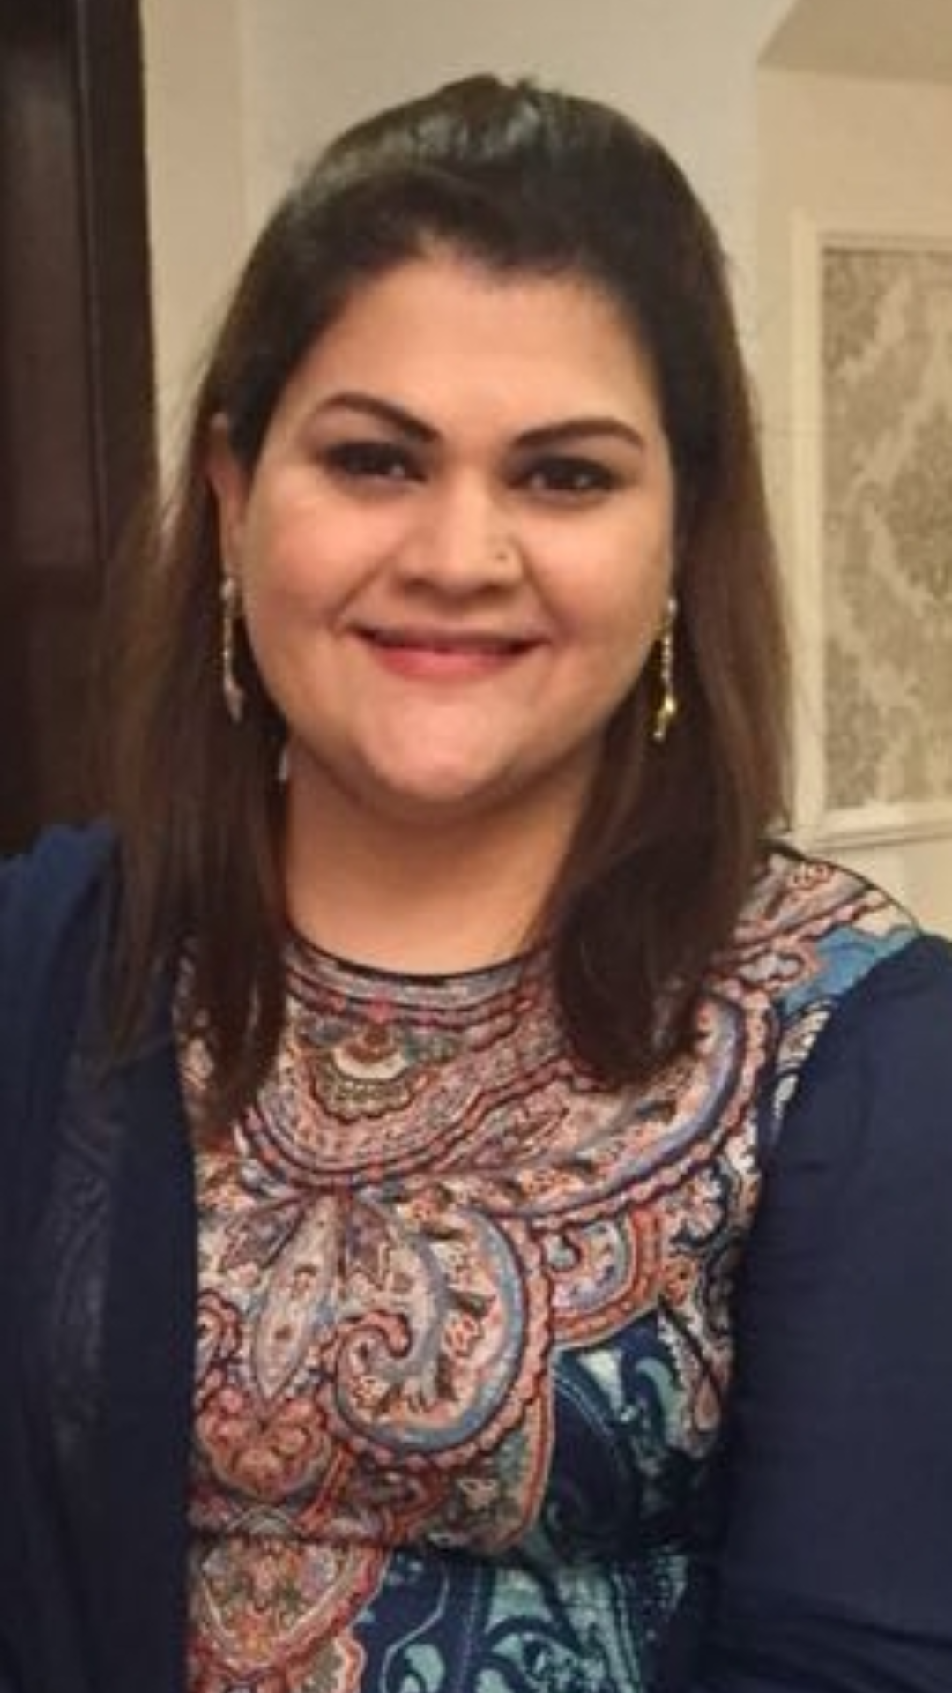
MS. SAMA ADIL – COUNSELLOR
EMAIL ID: sama.adil@deensacademy.com

